Slide 1
TELCO CUSTOMERS CHURN PREDICTION
Ikhbar Firman Hanafi

Slide 2
PROBLEM STATEMENT
Telecom companies face major challenge with customer churn, as customers switch to alternate provider due to various reasons like lower cost, multi (combo) service offerings, marketing promotions by competitors, etc.
In the USA, there are 7 telecom companies that serve customers in all 50 states. 13 regional companies serve 29 plus states and thousands of local companies provide internet and TV broadcasting services#.
Identifying these potential customers early on who may voluntarily churn and providing them retention incentives in form of discounts & combo offers will help the organization to retain those customers and reduce revenue loss.
The company can also internally study any possible operational causes and improve its product offerings.
Proactive actions will prevent the loss of revenue for the company and will improve / retain the market share among the industry peers in terms of the number of active subscribers.
Telecom companies face major challenge with customer churn, as customers switch to alternate provider due to various reasons like lower cost, multi (combo) service offerings, marketing promotions by competitors, etc.
In the USA, there are 7 telecom companies that serve customers in all 50 states. 13 regional companies serve 29 plus states and thousands of local companies provide internet and TV broadcasting services#.
Identifying these potential customers early on who may voluntarily churn and providing them retention incentives in form of discounts & combo offers will help the organization to retain those customers and reduce revenue loss.
The company can also internally study any possible operational causes and improve its product offerings.
Proactive actions will prevent the loss of revenue for the company and will improve / retain the market share among the industry peers in terms of the number of active subscribers.
Customers churn refers to the amount of customers of a given company that stop using products or services during a certain time frame. At this time Telecom companies face major challenge with customer churn, as customers switch to alternate provider due to various reasons like lower cost, multi (combo) service offerings, marketing promotions by competitors, etc. Identifying these potential customers early on who may voluntarily churn and providing them retention incentives in form of discounts & combo offers will help the organization to retain those customers and reduce revenue loss.
OBJECTIVE
Predict potential customers who may voluntarily churn

Slide 3
DATA DESCRIPTION
Data consists of 7043 customers who belong to various demographics (single; with dependents; senior citizen) and subscribe to different products offerings (internet service; phone line; streaming TV; streaming movies; online security) from a telecom company located in one of the US states.
Independent variables: 17 Categorical and 3 Numerical
Dependent Target variable: “Churn”
“” Customer ID
“” Gender
“” Senior Citizen
“” Partner
“” Dependents
# Tenure
“” Phone Service
“” Multiple Lines
“” Internet Service
“” Online Security
“” Online Backup
“” Device Protection
“” Tech Support
“” Streaming TV
“” Streaming Movies
“” Contract
“” Paperless Billing
“” Payment Method
# Monthly Charges
# Total Charges
Dataset source: www.kaggle.com/blastchar/telco-customer-churn
“” Churn

Slide 4
OUR PROCESS
MODEL INFERENCE
DEFINE MODELS
EXPLORE DATA
EVALUATION
ANN
Get prediction from each models and evaluate the results
Find some information from customers that related to churn
Pickup the best model and applied to different data
Create and train several model with different kinds of architecture neural network

Slide 5
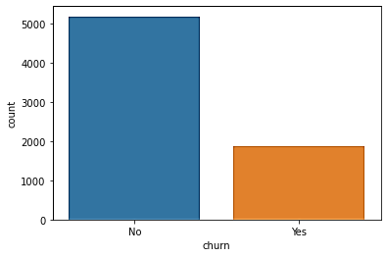
Exploratory Data Analysis
Churn Distribution
5174
There’s about 27% customer’s who left within last month
1869

Slide 6
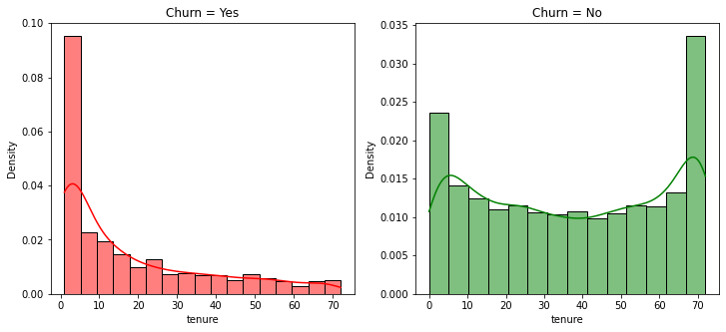
Customer Tenure

Slide 7
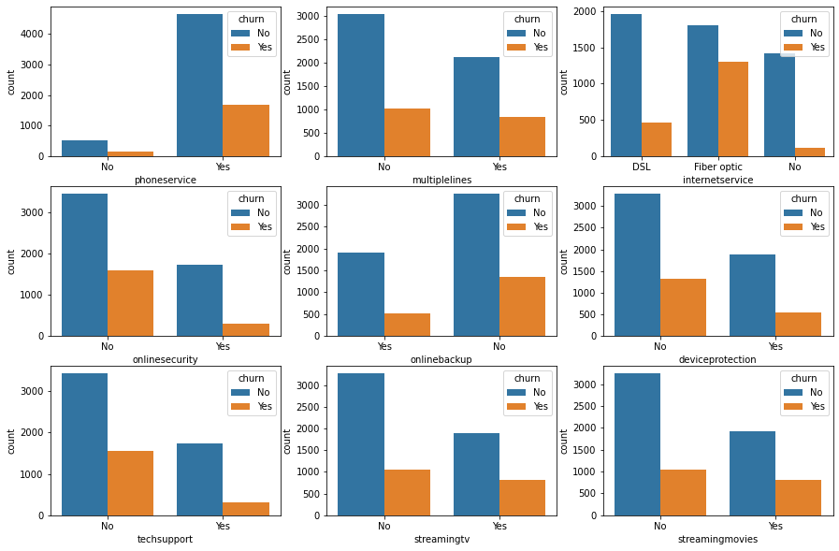
Products

Slide 8
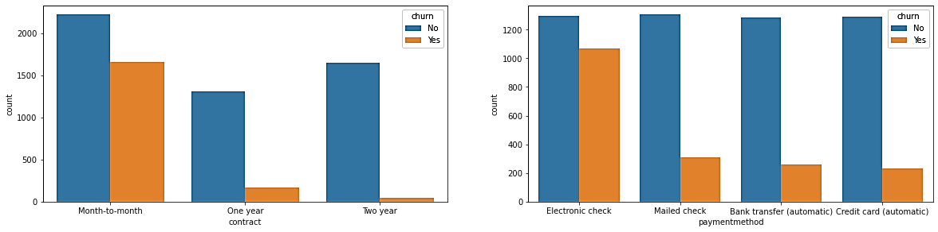
Contract and Payment

Slide 9
INSIGHT
SUGGESTION
Individuals with Fiber Optic churn More compared to ones using DSL
No Security Services, Device Protection, Tech support, Online Backup increases the Churn Rates
88% Churn customers is month-to-month contract
Improve Security Services, Device Protection, Tech support and Online Backup to decrease the rate of churn
We must provide Churn customers is month-to-month contract with offers, discounts and good service in order to remain in the company

Slide 10
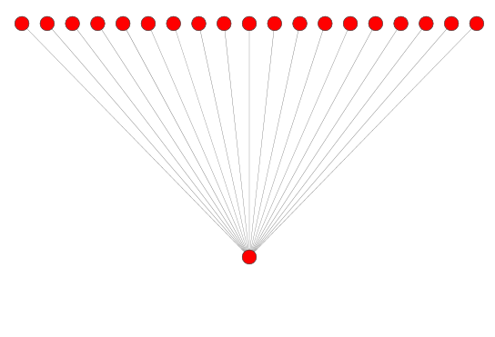
ANN Model
01
Sequential
Input layers (19,)
No hidden layers, just input and output with sigmoid activation function
Metrics: Recall
Output layers (Sigmoid)

Slide 11
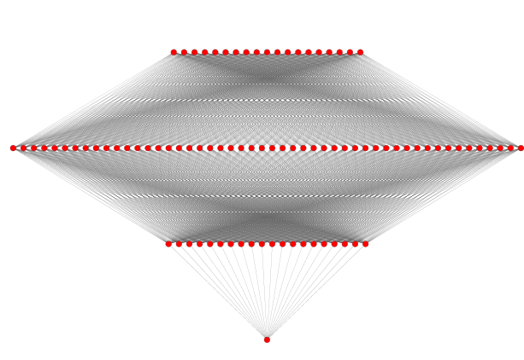
ANN Model
Sequential
Input layers (19,)
Hidden layers 50 nodes (ReLu)
02
Hidden layers 20 nodes (ReLu)
Two hidden layers and output with batch normalization
Optimizer: Stochastic gradient descent
Loss function: Binary cross entropy
Metrics: Recall
Output layers (Sigmoid)

Slide 12
ANN Model
03
Functional
Input layers (19,)
Hidden layers 50 nodes (ReLu)
Hidden layers 20 nodes (ReLu)
Two hidden layers and output with batch normalization
Optimizer: Stochastic gradient descent
Loss function: Binary cross entropy
Metrics: Recall
Output layers (Sigmoid)

Slide 13
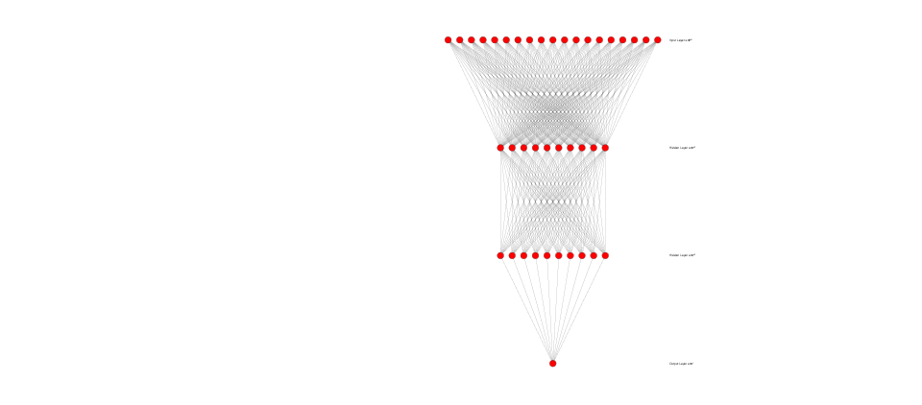
ANN Model
04
Functional
Input layers (19,)
Hidden layers 10 nodes (ReLu)
Hidden layers 10 nodes (ReLu)
Two hidden layers and output with batch normalization
Optimizer: Stochastic gradient descent
Loss function: Binary cross entropy
Metrics: Recall
Output layers (Sigmoid)

Slide 14
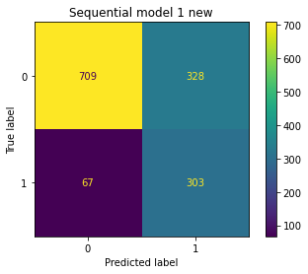
EVALUATION
The best model is 2th sequential model by considering recall and accuracy score.
82% of customers predicted correctly from all customers who will left within last month (recall score)
72% of customers predicted correctly (accuracy score)

Slide 15
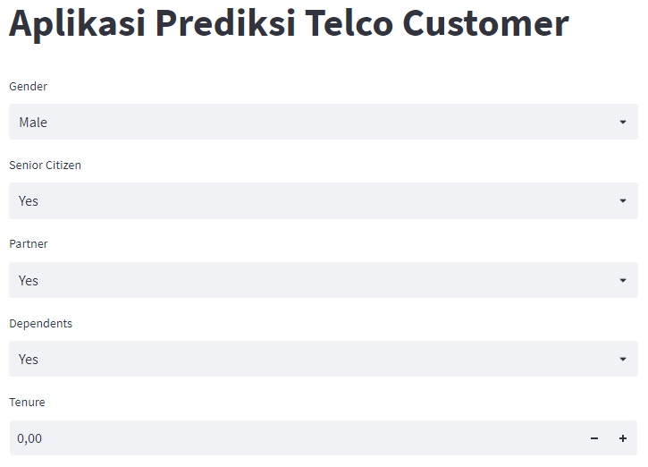
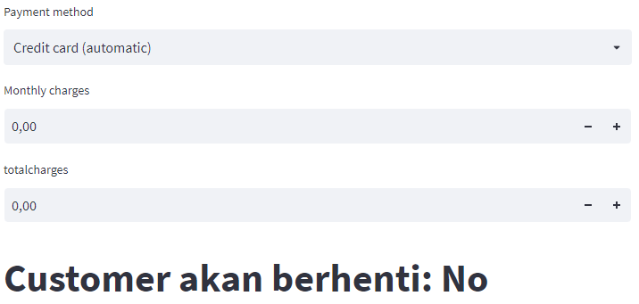
MODEL INFERENCE
https://p2ml1-ikhbarfirman.herokuapp.com/

Slide 16
THANKS

